Slide 1
Exercise 1 Railway Safety Invariants
Exercise in UML-B Class and Context Diagram modelling
Colin Snook

Slide 2
Specification: Railway Interlocking Safety Requirements
A Railway interlocking system controls trains passing through a track layout by changing the state of Signals which can be Proceed, Warning and Stop.
The signal immediately before another signal is said to be RearOf the second signal.
The track layout is divided into Routes. Each Route has an Entry signal at its start.
Some Routes Conflict with others (e.g. use the same section of track). A route is locked before it is used and then unlocked again.
The following safety requirements are specified:
SR1 - If a signal shows Stop, the signal RearOf it must show Stop or Warning
SR2 - If the entry signal of a route shows Proceed or Warning, then the Route is locked
SR3 - If a route is locked then no route that conflicts with it is locked

Slide 3
Instructions: Railway Interlocking Safety Requirements (cont.)
Model this domain in just enough detail to be able to express the safety requirements.
Use a UML-B Context diagram for the static parts and a Class Diagram for the varying parts. (Link the Classes to the ClassTypes using the Instances property of the Class).
Add invariants to your model to reflect these requirements.
Add guards to your events to ensure the system does not violate the invariants.
Verify the model using the prover

Slide 4
Analysis
Our aim is to keep the model as simple as possible. We just want enough detail to be able to express the safety requirements as invariants and no more.
Looking at SR1 we need to model a set of Signals. Signals have exactly one associated RearOf signal. This is a constant* so we should model it in a Context Diagram (That means we will have to make Signal a ClassType in a Context Diagram).
We need to talk about the state of Signals (called ‘aspect’ in railway jargon) so we will need to define an enumerated type. We can do this with a Class Type that has instances set to {Proceed,Warning,Stop}.
Since the aspect of the Signal varies we will need to model that in a Class Diagram. So we need a Class signal that is linked to the ClassType Signal . We will need events to set each state. (Note that it is better to model separate setter events for each state so that we can put different guards on each of them)
* Actually rearOf might depend on which routes are currently locked but for simplicity we assume it is a constant for now

Slide 5
Analysis (cont.)
From SR2 we need to model a set of Routes. Routes have an associated Entry Signal which we can model as an association. Again this is a constant, so we will put it in a ClassType on the Context Diagram. Routes can be locked and unlocked. We could model that as a boolean variable attribute, ‘locked’, in a linked Class and we will need lock and unlock events to change it.
Finally, from SR3 routes may be in conflict with other routes. This is a constant association from Routes to Routes so we should put it as a ‘self’ loop in the ClassType for Routes. Since each route may have none or many conflicting routes we will make this a multiplicity many association (i.e. relation).
* Actually rearOf might depend on the which routes are currently locked but for simplicity we assume it is a constant for now

Slide 6
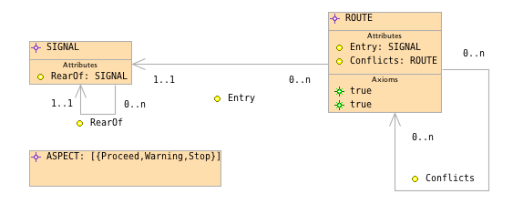
Context Diagram

Slide 7
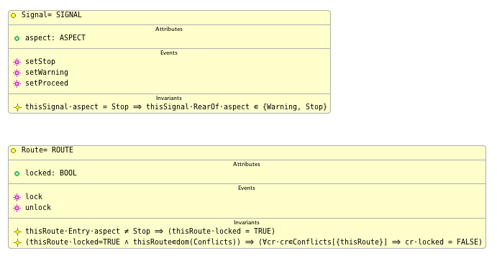
Class Diagram

Slide 8
Class Diagram with guards and actions
guard: thisSignal⋅RearOf⋅aspect ∈ {Warning, Stop}
action: thisSignal⋅aspect ≔ Stop
guard: ∀r·r∈Entry∼[{thisSignal}] ⇒ (r⋅locked = TRUE)
action: thisSignal⋅aspect ≔ Warning
guard: ∀s·s ∈ RearOf∼[{thisSignal}] ⇒s⋅aspect ≠ Stop
guard: ∀r·r∈Entry∼[{thisSignal}] ⇒ (r⋅locked = TRUE)
action: thisSignal⋅aspect ≔ Proceed
guard: ∀cr·cr∈Conflicts[{thisRoute}] ⇒ cr⋅locked = FALSE
action: thisRoute⋅locked ≔ TRUE
guard: thisRoute⋅Entry⋅aspect = Stop
action: thisRoute⋅locked ≔ FALSE

Slide 9
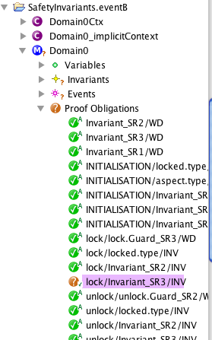
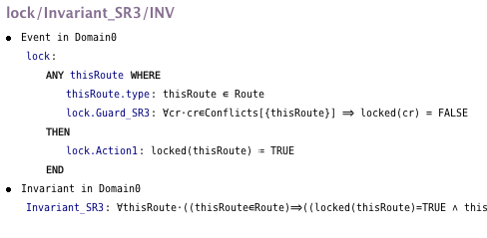

One proof obligation does not prove automatically
Could the lock event violate the
SR3 conflicts invariant

Slide 10
The Lock event
locked route
un-locked route
changes from
unlocked to locked
conflicting routes
conflicts
thisRoute
the lock event checks that the set
of conflicting routes contains no
locked routes before locking ‘thisRoute’

Slide 11
A route that conflicts with itself
locked route
What if conflicts contains thisRoute?
then the invariant breaks
un-locked route
changes from
unlocked to locked
conflicting routes
conflicts
thisRoute
thisRoute

Slide 12
A route that conflicts with itself
We can disallow this in our definition
of conflicts because a route cannot conflict with itself
locked route
un-locked route
changes from
unlocked to locked
conflicting routes
conflicts
thisRoute
thisRoute

Slide 13
Symmetry
What if we lock one of the conflicting routes later on in another lock event…
then the invariant breaks
locked route
un-locked route
changes from
unlocked to locked
conflicting routes
thisRoute_2
conflicts
thisRoute

Slide 14
Symmetry
We prevent this by insisting on symmetry so that the guard in the lock event prevents us from locking thisRoute2 when thisRoute is already locked.
Our real-life concept of conflicts is symmetric.
conflicting routes
conflicting routes
thisRoute_2
conflicts
thisRoute
locked route
un-locked route

Slide 15
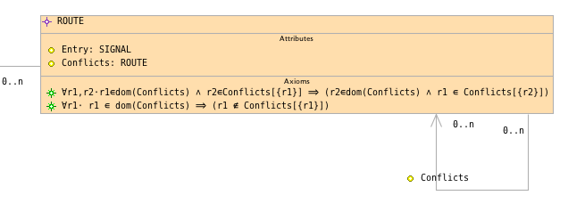
New Axioms added to ROUTE
The axioms make our definition of Conflicts more precise.

Slide 16

Now everything proves

